Slide 1
Kochen-Specker Theorem in QIVPM

Slide 2
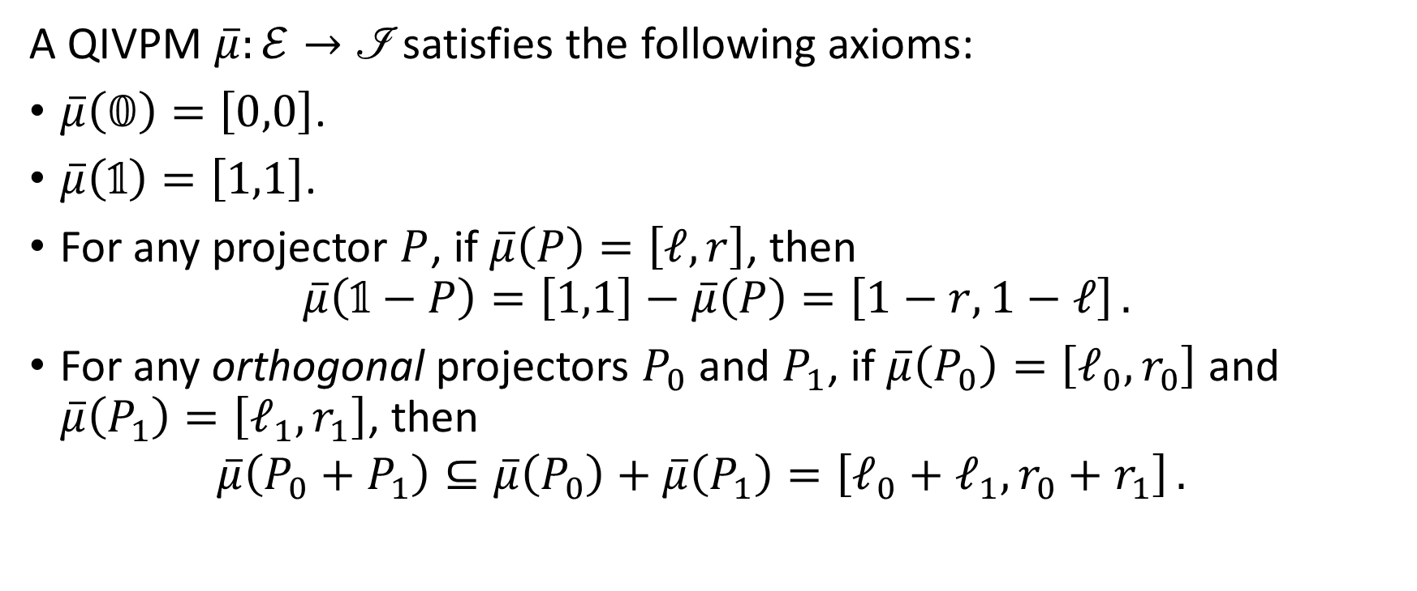
Quantum Interval-Valued Probability Measure (QIVPM)
A QIVPM $\overline{μ}:ℰ→\text{ℐ}$ satisfies the following axioms:
$\overline{μ}\left(𝟘\right)=\left[0,0\right]$.
$\overline{μ}\left(𝟙\right)=\left[1,1\right]$.
For any projector $P$, if $\overline{μ}\left(P\right)=\left[ℓ,r\right]$, then $\overline{μ}\left(𝟙−P\right)=\left[1,1\right]−\overline{μ}\left(P\right)=\left[1−r,1−ℓ\right] .$
For any orthogonal projectors $P_{0}$ and $P_{1}$, if $\overline{μ}\left(P_{0}\right)=\left[ℓ_{0},r_{0}\right]$ and $\overline{μ}\left(P_{1}\right)=\left[ℓ_{1},r_{1}\right]$, then $\overline{μ}\left(P_{0}+P_{1}\right)⊆\overline{μ}\left(P_{0}\right)+\overline{μ}\left(P_{1}\right)=\left[ℓ_{0}+ℓ_{1},r_{0}+r_{1}\right] .$
Notes:
XITS font is required to display Formal Script (\mathscr) font correctly.
https://www.ctan.org/tex-archive/fonts/xits/

Slide 3
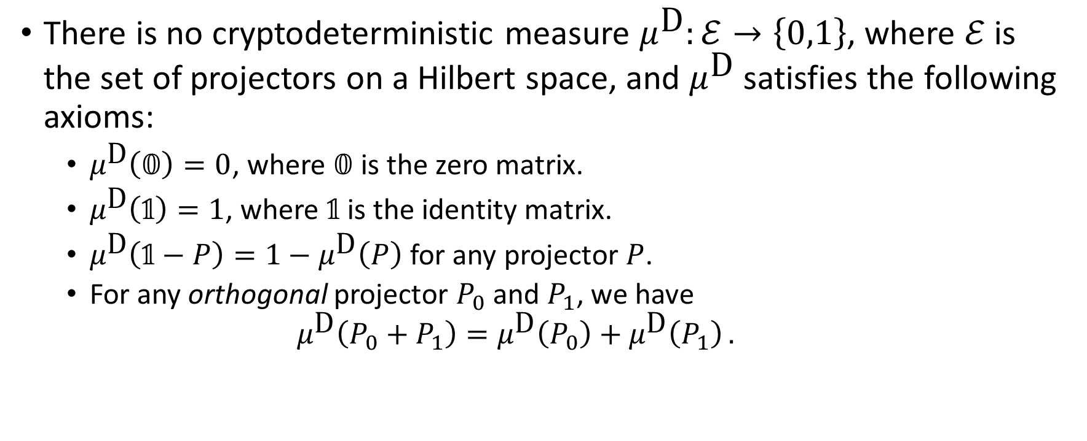
Kochen-Specker Theorem
There is no cryptodeterministic measure $μ^{\text{D}}:ℰ→\left\{0,1\right\}$, where $ℰ$ is the set of projectors on a Hilbert space, and $μ^{\text{D}}$ satisfies the following axioms:
$μ^{\text{D}}\left(𝟘\right)=0$, where $𝟘$ is the zero matrix.
$μ^{\text{D}}\left(𝟙\right)=1$, where $𝟙$ is the identity matrix.
$μ^{\text{D}}\left(𝟙−P\right)=1−μ^{\text{D}}\left(P\right)$ for any projector $P$.
For any orthogonal projector $P_{0}$ and $P_{1}$, we have $μ^{\text{D}}\left(P_{0}+P_{1}\right)=μ^{\text{D}}\left(P_{0}\right)+μ^{\text{D}}\left(P_{1}\right) .$

Slide 4
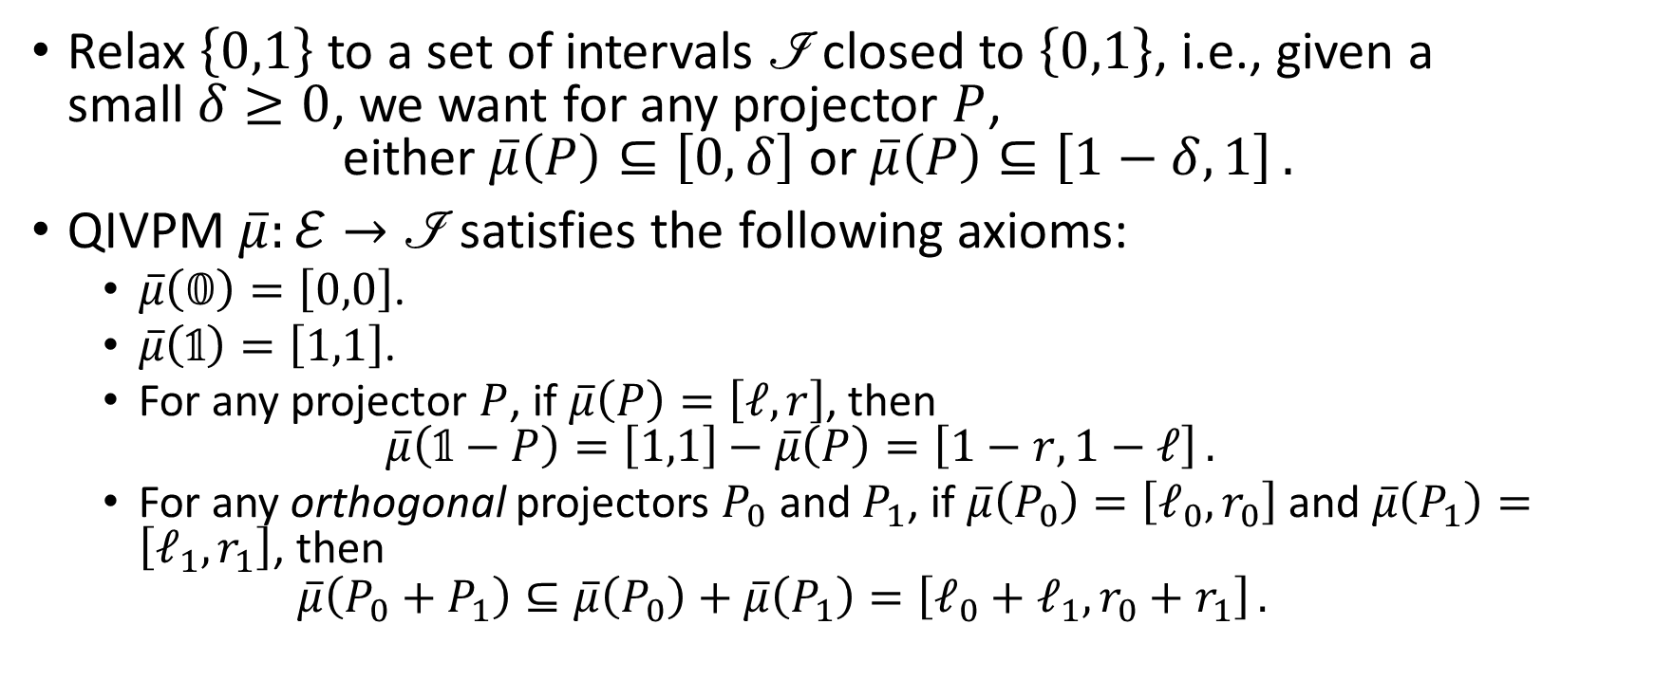
Finite Precision Measurement
Relax $\left\{0,1\right\}$ to a set of intervals $\text{ℐ}$ closed to $\left\{0,1\right\}$, i.e., given a small $δ≥0$, we want for any projector $P$, $\text{either} \overline{μ}\left(P\right)⊆\left[0,δ\right] \text{or} \overline{μ}\left(P\right)⊆\left[1−δ,1\right] .$
QIVPM $\overline{μ}:ℰ→\text{ℐ}$ satisfies the following axioms:
$\overline{μ}\left(𝟘\right)=\left[0,0\right]$.
$\overline{μ}\left(𝟙\right)=\left[1,1\right]$.
For any projector $P$, if $\overline{μ}\left(P\right)=\left[ℓ,r\right]$, then $\overline{μ}\left(𝟙−P\right)=\left[1,1\right]−\overline{μ}\left(P\right)=\left[1−r,1−ℓ\right] .$
For any orthogonal projectors $P_{0}$ and $P_{1}$, if $\overline{μ}\left(P_{0}\right)=\left[ℓ_{0},r_{0}\right]$ and $\overline{μ}\left(P_{1}\right)=\left[ℓ_{1},r_{1}\right]$, then $\overline{μ}\left(P_{0}+P_{1}\right)⊆\overline{μ}\left(P_{0}\right)+\overline{μ}\left(P_{1}\right)=\left[ℓ_{0}+ℓ_{1},r_{0}+r_{1}\right] .$
Notes:
XITS font is required to display Formal Script (\mathscr) font correctly.
https://www.ctan.org/tex-archive/fonts/xits/

Slide 5
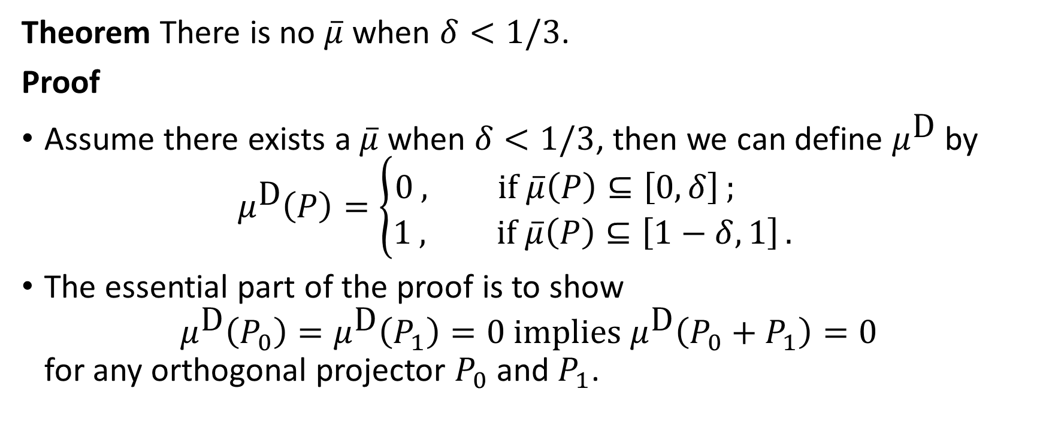
Kochen-Specker Theorem with Finite Precision Measurement
Theorem There is no $\overline{μ}$ when $δ<1/3$.
Proof
Assume there exists a $\overline{μ}$ when $δ<1/3$, then we can define $μ^{\text{D}}$ by $μ^{\text{D}}\left(P\right)=\left\{\begin{aligned}0 , \text{if} \overline{μ}\left(P\right)⊆\left[0,δ\right] ; \\ &1 , \text{if} \overline{μ}\left(P\right)⊆\left[1−δ,1\right] .\end{aligned}\right.$
The essential part of the proof is to show $μ^{\text{D}}\left(P_{0}\right)=μ^{\text{D}}\left(P_{1}\right)=0 \text{implies} μ^{\text{D}}\left(P_{0}+P_{1}\right)=0$ for any orthogonal projector $P_{0}$ and $P_{1}$.

Slide 6

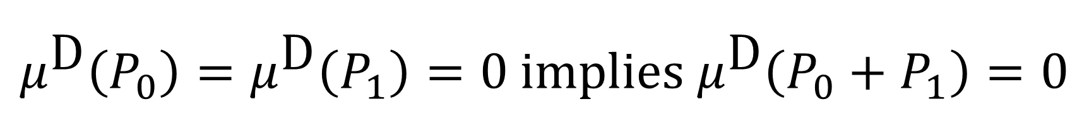







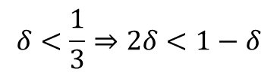
$$μ^{\text{D}}\left(P_{0}\right)=μ^{\text{D}}\left(P_{1}\right)=0 \text{implies} μ^{\text{D}}\left(P_{0}+P_{1}\right)=0$$
$$μ^{\text{D}}\left(P_{0}\right)=μ^{\text{D}}\left(P_{1}\right)=0 \\ ⇒\overline{μ}\left(P_{0}\right)⊆\left[0,δ\right] \text{and} \overline{μ}\left(P_{1}\right)⊆\left[0,δ\right] \\ ⇒\overline{μ}\left(P_{0}+P_{1}\right)⊆\left[0,2δ\right]$$
$\overline{μ}\left(P_{0}+P_{1}\right)$ is in this area
$$1−δ$$
$$1$$
$$0$$
$$δ$$
$$2δ$$
$$δ<\frac{1}{3}⇒2δ<1−δ$$
$\overline{μ}\left(P_{0}+P_{1}\right)$ should be in either one of these areas
$$∴\overline{μ}\left(P_{0}+P_{1}\right)⊆\left[0,δ\right] \\ ⇒μ^{\text{D}}\left(P_{0}+P_{1}\right)=0$$

